Slide 1
Project name : Hospitality Finance Domain : Hospitality

Slide 2
Introduction
Begin by introducing the hospitality industry, highlighting its diverse sectors, including hotels, restaurants, travel, and events.
Financial Landscape in Hospitality
Significance of Financial Analysis
Key Financial Metrics
Customer Satisfaction and Finances
Operational Efficiency
Data-Driven Decision Making
Analysing Hospitality Finance
Forecasting and Planning
Competitive Advantage
Importance of Dashboard
Purpose of Presentation

Slide 3
DATASET DESCRIPTION
Acquisition Date:
Date when the property or asset was acquired.
Brand:
The brand or franchise associated with the hospitality property.
City:
The city where the hospitality property is located.
Country:
The country where the hospitality property is situated.
Year:
The year in which the financial data was recorded.
Property:
Specific details about the hospitality property, including property names or unique identifiers.
State:
The state or region where the hospitality property is located.
Net Operating Income:
The net operating income for the hospitality property, representing total revenue minus total operating expenses.
Total Departmental Expenses:
The sum of all expenses related to different departments within the hospitality property.

Slide 4
DATASET DESCRIPTION
Total FF&E Reserves:
The total reserves set aside for Furniture, Fixtures, and Equipment (FF&E).
Total Management Fees:
The cumulative management fees associated with the operation of the hospitality property.
Total Non Operating Expenses:
The total non-operating expenses incurred by the hospitality property.
Total Revenue:
The overall revenue generated by the hospitality property.
Total Rooms Available:
The total number of rooms available in the hospitality property.
Total Rooms Revenue:
The revenue generated specifically from room bookings.
Total Rooms Sold:
The total number of rooms sold during the recorded period.
Total Undistributed Expenses:
The total undistributed expenses not attributed to specific departments.

Slide 5
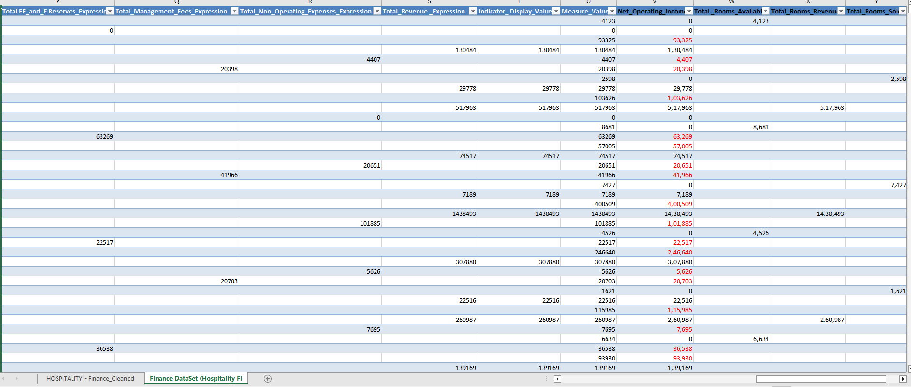
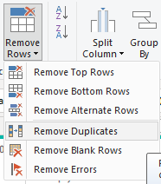
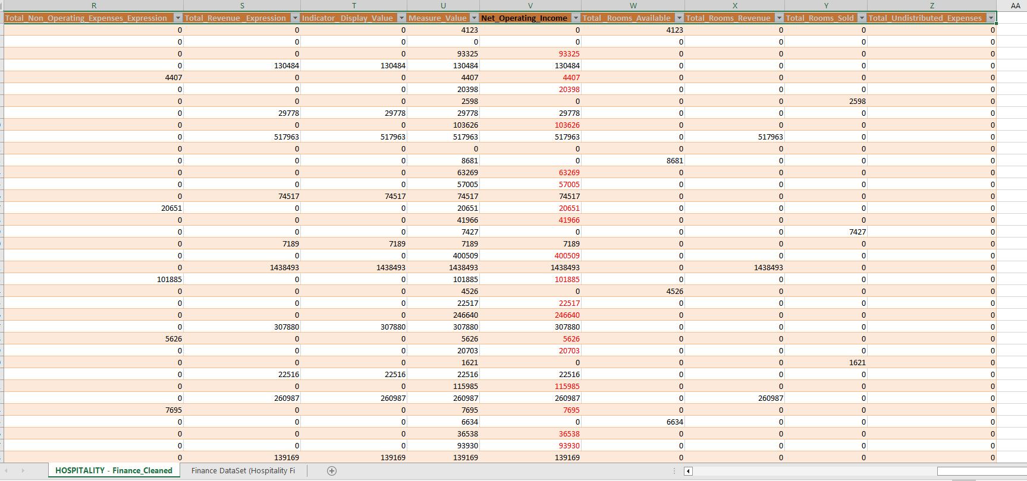
Data Cleaning:
Replacing Null values wit Zero & Delete extra columns
BEFORE
Replacing unwanted characters.
Inconsistencies
Duplicates
Incorrect format
Missing values
Duplicates & Missing values
AFTER

Slide 6
KPI Explanation
Total Expenses
Total Departmental Expenses:
The cumulative expenses incurred across various departments, amounting to ₹62,27,63,247.
Total FF&E Reserves:
Reserves set aside for Furniture, Fixtures, and Equipment (FF&E), totalling ₹6,97,24,218.
Total Management Fees:
The sum of management fees associated with the operation, totalling ₹2,43,16,537.
Total Revenue:
Overall revenue generated, amounting to ₹85,62,59,476.

Slide 7
Room Metrics
Total Rooms Available:
The total number of rooms available, reaching 78,73,155.
Total Rooms Revenue:
Revenue specifically generated from room bookings, totalling ₹65,55,42,900.
Total Rooms Sold:
The total number of rooms sold during the recorded period, amounting to 46,14,498.

Slide 8
Expense Metrics
Total Undistributed Expenses:
Overall undistributed expenses not attributed to specific departments, totalling ₹16,07,37,890.
The percentage of Gross Operating Income in relation to Total Revenue, indicating a 27.27% margin.
Gross Operating Profit:
The profit after deducting all operating expenses, amounting to ₹7,27,58,339.
Gross Operating Profit %:
The percentage of Gross Operating Profit in relation to Total Revenue, indicating an 8.50% margin.

Slide 9
Additional Metrics: Occupancy Rate
Total OCC (Occupancy Rate):
The overall occupancy rate, indicating that 58.61% of the available rooms are occupied.
These KPIs provide a comprehensive overview of the financial and operational performance of the hospitality establishment during the recorded period.
1 Average Daily Rate (₹142.06):
Insight: The average daily rate gives insight into the pricing strategy and reflects the average revenue generated per room per day.

Slide 10
Occupancy and Additional Metrics
Total OCC (Occupancy Rate - 58.61%):
Insight: The occupancy rate provides insights into how well the available rooms are utilized. A balance between demand and capacity is essential for optimal revenue.
RevPAR (₹83.26):
Insight: Revenue per available room is a key metric indicating the establishment's ability to generate revenue from each room, considering both occupancy and pricing.
EBITDA (₹22.21M):
Insight: EBITDA reflects operational profitability and can be used to assess the establishment's financial health.
EBITDA % (2.59%):
Insight: The EBITDA percentage indicates the proportion of revenue that contributes to earnings before interest, taxes, depreciation, and amortization.

Slide 11

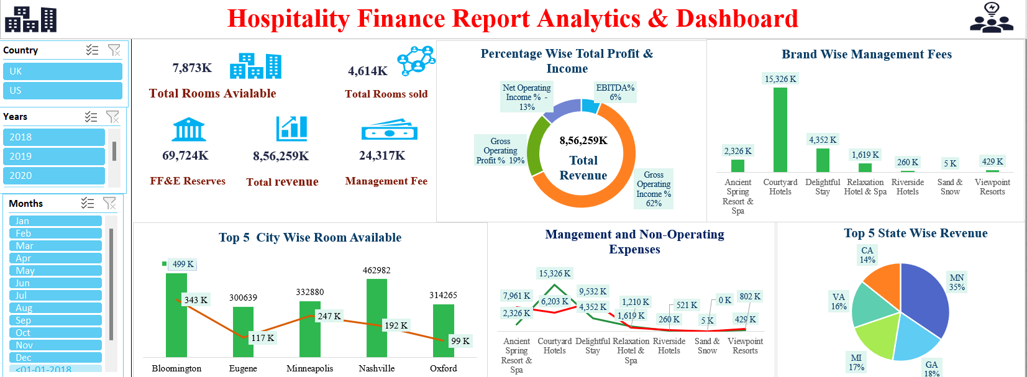
DASHBOARD

Slide 12

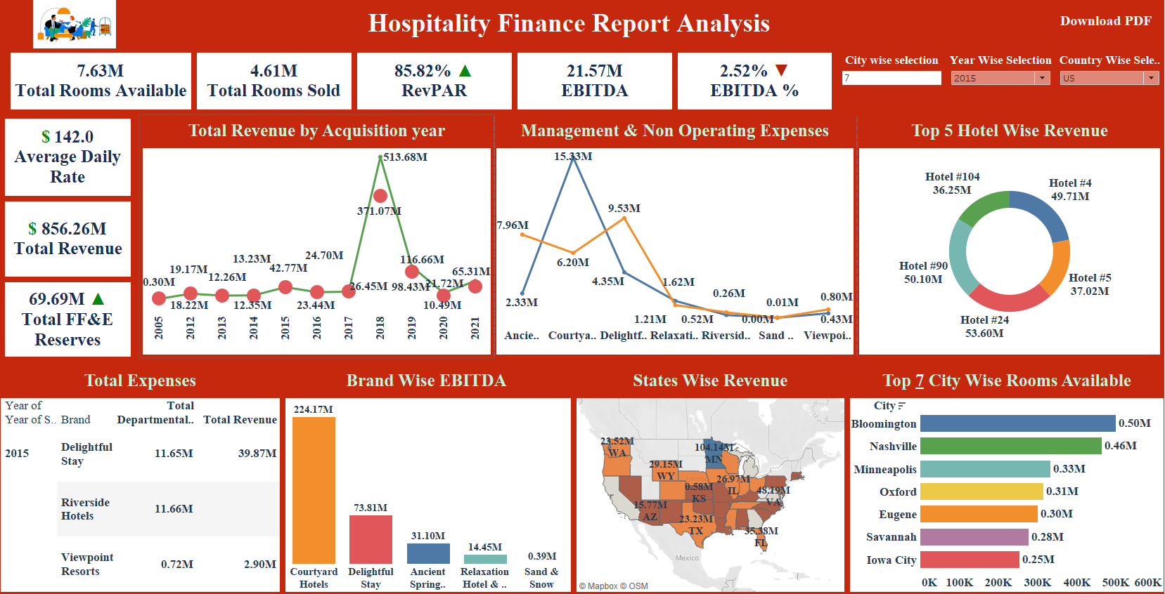
DASHBOARD

Slide 13

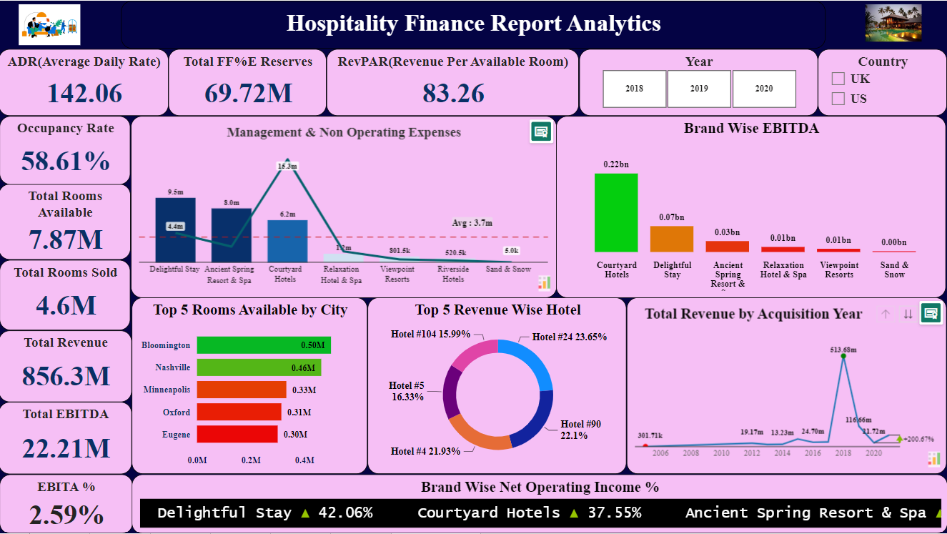
DASHBOARD

Slide 14
Conclusion
The hospitality finance project presented a comprehensive exploration of the industry's financial landscape, integrating diverse data sources to derive meaningful insights.
The dashboard creation process highlighted the significance of key performance indicators (KPIs) such as total room availability, rooms sold, total revenue, and others. These metrics not only shaped the dashboard's design but also became focal points for assessing the financial health of hospitality establishments.
Despite challenges, the project yielded valuable insights into the industry's operational efficiency, revenue generation, and overall financial performance. The emphasis on top cities with the highest room counts and the representation of percentage-wise total profit and income through visualizations added depth to the analysis.
However, the negative net operating income percentage uncovered potential financial challenges, signaling a need for further investigation into cost structures and revenue streams. Addressing these challenges can pave the way for strategic improvements, ensuring a more robust financial foundation for hospitality establishments.
In conclusion, the project not only provided a nuanced understanding of hospitality finance but also underscored the importance of thoughtful KPI selection, data integrity, and effective visualization in delivering actionable insights.

Slide 15

Challenges faced for the project
I'd be happy to share the challenges we encountered during the “Hospitality Finance."
‘Hospitality Finance ' project aimed to analyze Customer Hospitality data, generate insights, and provide actionable recommendations within a three-month timeline.“
Challenges we encountered during the project:
Data Quality Issues: During the project, we encountered data quality issues such as missing customer data, inconsistent formats like special characters, and Upper case lower case format. These issues required thorough data cleansing to ensure accurate analysis.
2. Data Cleaning and Preprocessing: We spent a significant portion of our project time cleaning and preprocessing the data. This included tasks like removing duplicate customer records, imputing missing order dates, and standardizing product names for consistency.
3. Data Integration: We had to integrate data from various sources, including customer data, order data, and product data, into a single dataset. This integration allowed us to perform comprehensive analyses that considered all relevant factors.
4. Scope Creep: Midway through the project, we experienced some scope creep when the client requested additional analyses beyond the initial project scope. While accommodating these requests, we carefully managed the impact on timelines and deliverables.
5. Technical Challenges: We faced technical challenges related to data storage capacity when dealing with large volumes of historical sales data. This required us to optimize our database and adopt data compression techniques to maintain performance.
6. Communication: We experienced communication challenges when updates and project status were not effectively communicated to all team members. To address this, we implemented regular project status meetings and improved documentation sharing.
Impact:
While these challenges did introduce some delays, our proactive approach and collaborative efforts helped us stay on track with the project timeline. We adjusted our plan to accommodate data preprocessing and cleaning tasks, ensuring that the final analysis was based on reliable data.
Achievements:
Despite these challenges, we pleased to report that we successfully delivered actionable insights and recommendations that have already had a positive impact on your E-commerce operations. Our team's dedication and problem-solving abilities allowed us to overcome these obstacles and achieve our project objectives.
This Photo by Unknown Author is licensed under CC BY
Gratitude:
We want to take this opportunity to thank you for your collaboration and support throughout the Hospitality Finance ' project. Your partnership was instrumental in overcoming these challenges and achieving our goals

Slide 16


